Slide 1
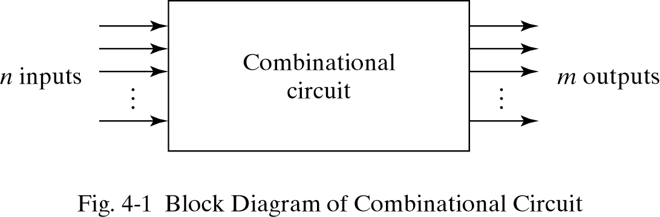
Combinational Logic
Logic circuits for digital systems may be combinational or sequential.
A combinational circuit consists of input variables, logic gates, and output variables.

Slide 2
4-2. Analysis procedure
To obtain the output Boolean functions from a logic diagram, proceed as follows:
Label all gate outputs that are a function of input variables with arbitrary symbols. Determine the Boolean functions for each gate output.
Label the gates that are a function of input variables and previously labeled gates with other arbitrary symbols. Find the Boolean functions for these gates.

Slide 3
4-2. Analysis procedure
Repeat the process outlined in step 2 until the outputs of the circuit are obtained.
By repeated substitution of previously defined functions, obtain the output Boolean functions in terms of input variables.

Slide 4
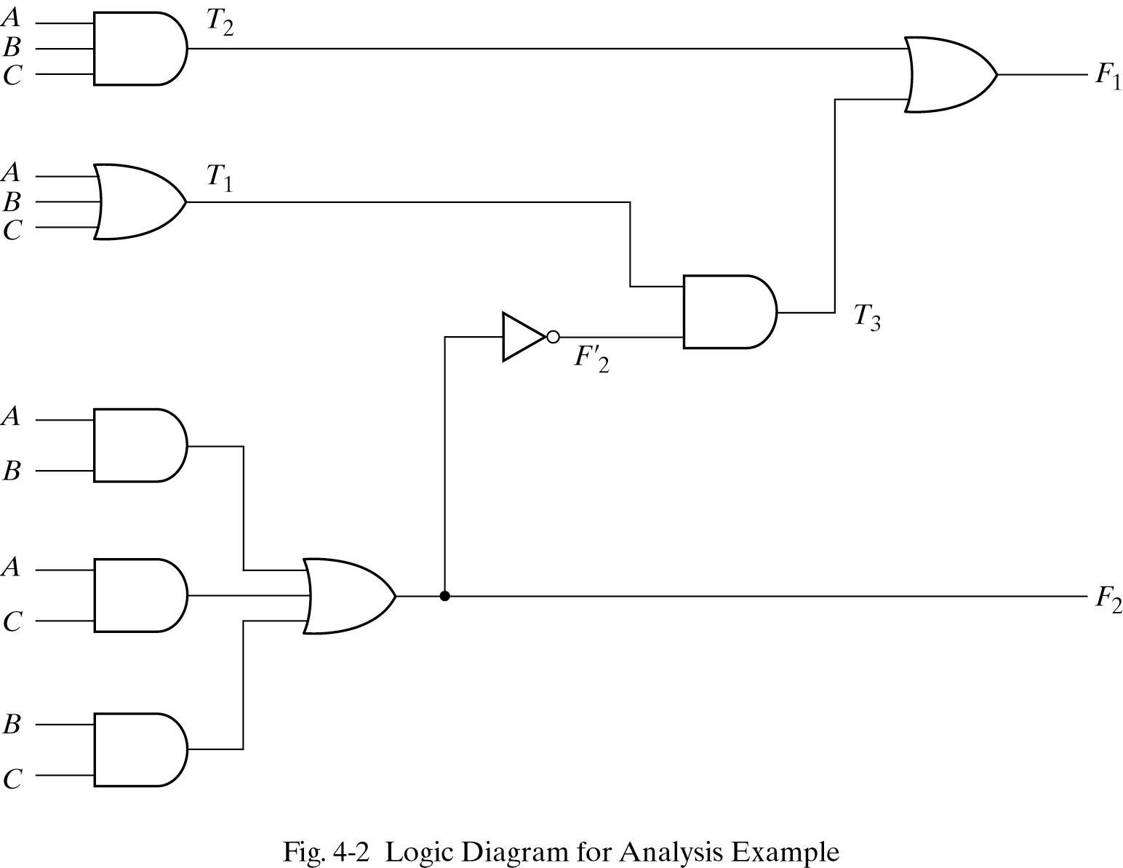
Example
F₂ = AB + AC + BC; T₁ = A + B + C; T₂ = ABC; T₃ = F₂’T₁;
F₁ = T₃ + T₂
F₁ = T₃ + T₂ = F₂’T₁ + ABC = A’BC’ + A’B’C + AB’C’ + ABC

Slide 5
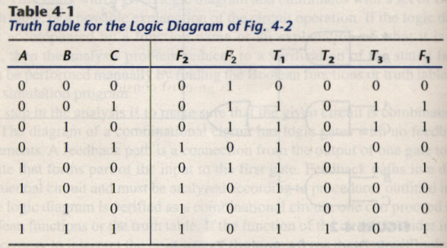
Derive truth table from logic diagram
We can derive the truth table in Table 4-1 by using the circuit of Fig.4-2.

Slide 6
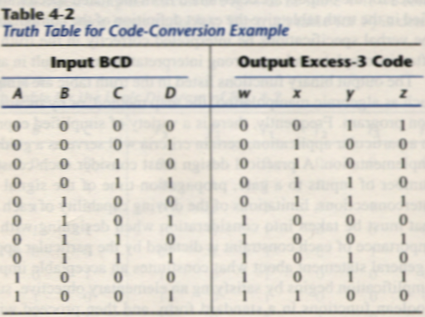
4-3. Design procedure
Table4-2 is a Code-Conversion example, first, we can list the relation of the BCD and Excess-3 codes in the truth table.

Slide 7
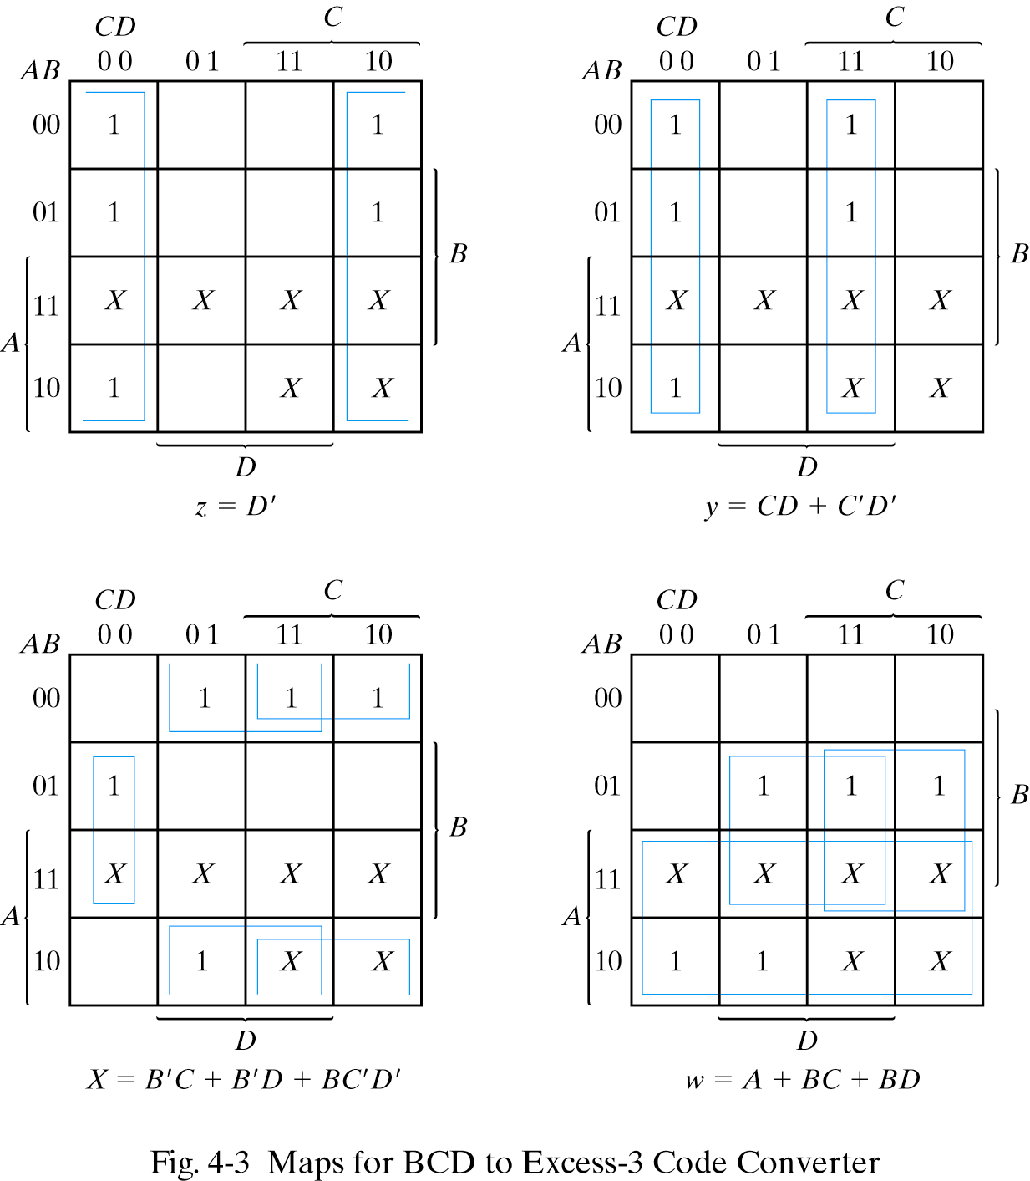
Karnaugh map
For each symbol of the Excess-3 code, we use 1’s to draw the map for simplifying Boolean function.

Slide 8
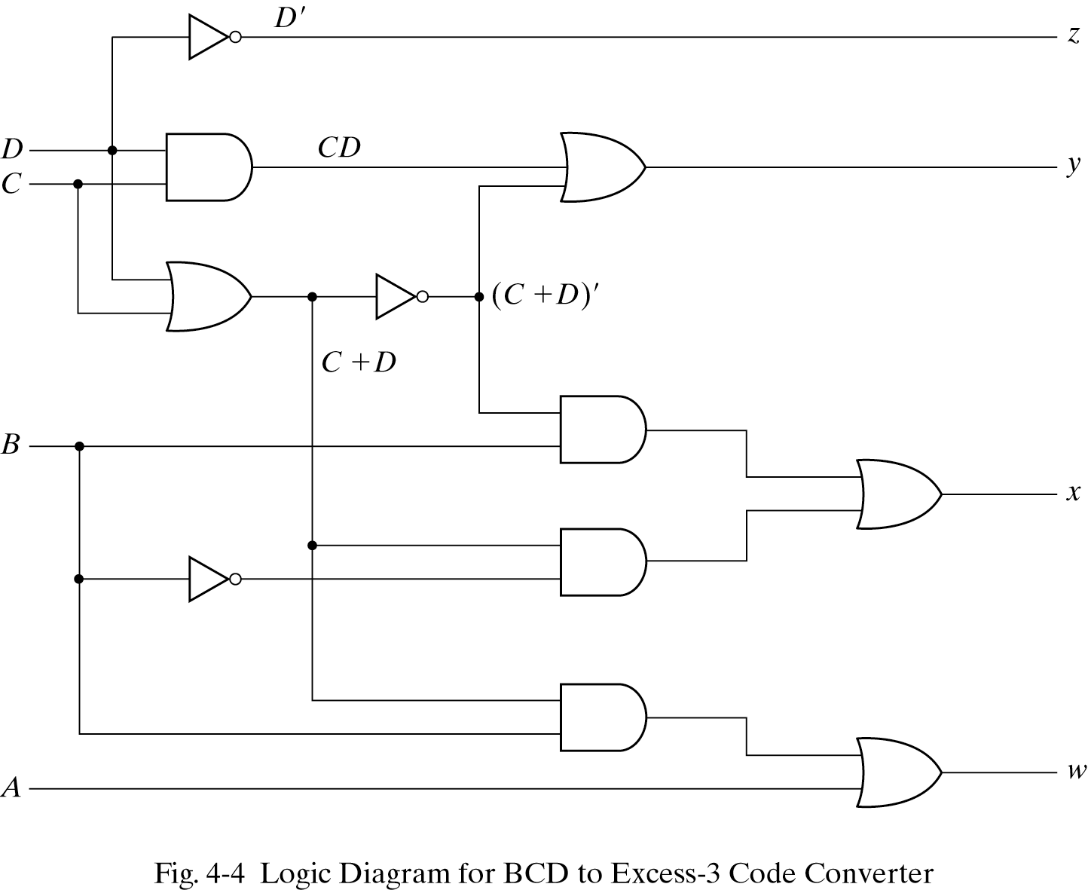
Circuit implementation
z = D’; y = CD + C’D’ = CD + (C + D)’
x = B’C + B’D + BC’D’ = B’(C + D) + B(C + D)’
w = A + BC + BD = A + B(C + D)

Slide 9
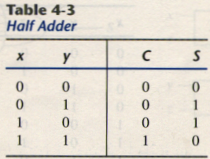
4-4. Binary Adder-Subtractor
A combinational circuit that performs the addition of two bits is called a half adder.
The truth table for the half adder is listed below:
S = x’y + xy’
C = xy
S: Sum
C: Carry

Slide 10
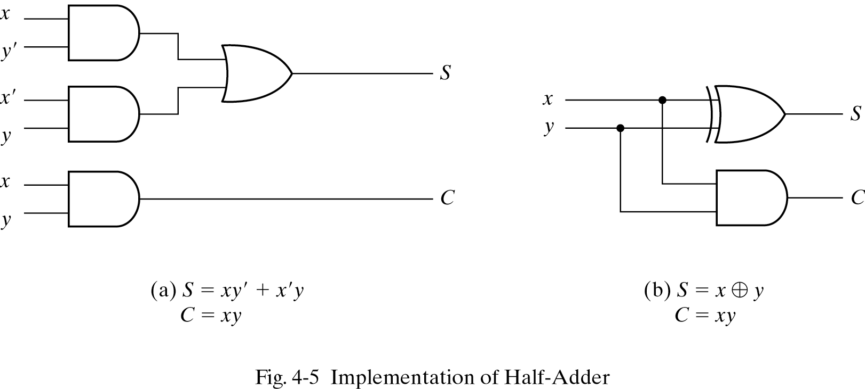
Implementation of Half-Adder

Slide 11
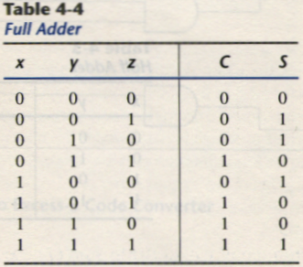
Full-Adder
One that performs the addition of three bits(two significant bits and a previous carry) is a full adder.

Slide 12
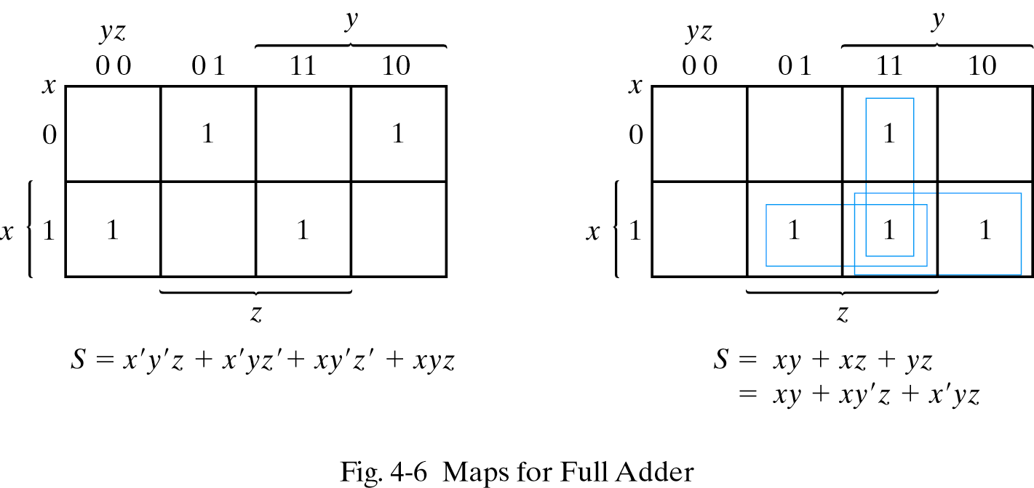
Simplified Expressions
C
S = x’y’z + x’yz’ + xy’z’ + xyz
C = xy + xz + yz

Slide 13
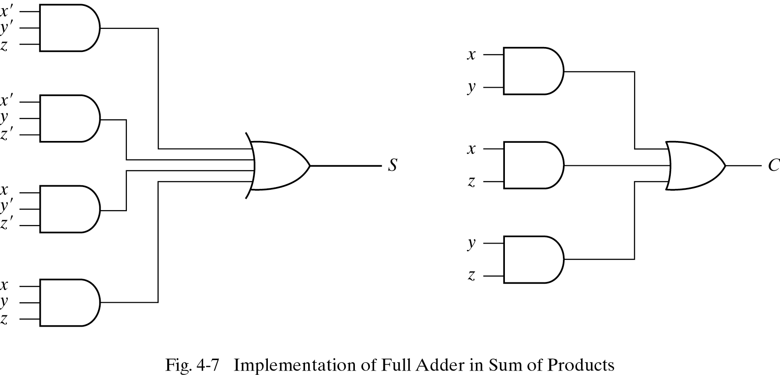
Full adder implemented in SOP

Slide 14
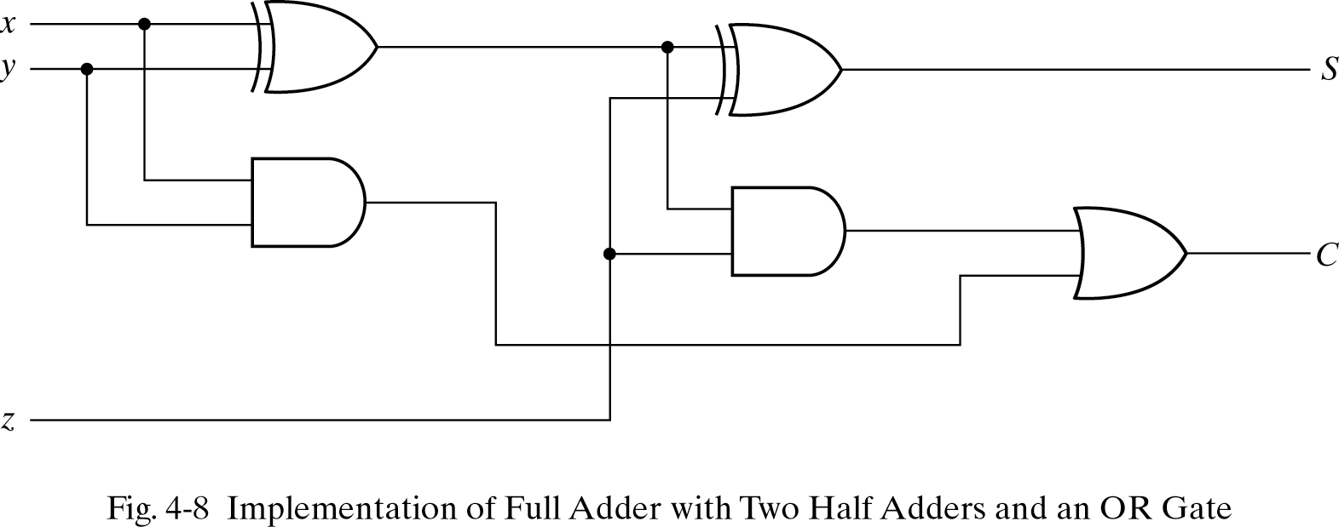
Another implementation
Full-adder can also implemented with two half adders and one OR gate (Carry Look-Ahead adder).
S = z ⊕ (x ⊕ y)
= z’(xy’ + x’y) + z(xy’ + x’y)’
= xy’z’ + x’yz’ + xyz + x’y’z
C = z(xy’ + x’y) + xy = xy’z + x’yz + xy

Slide 15
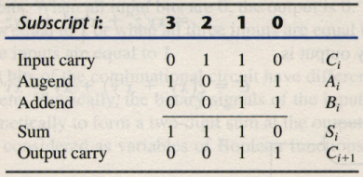
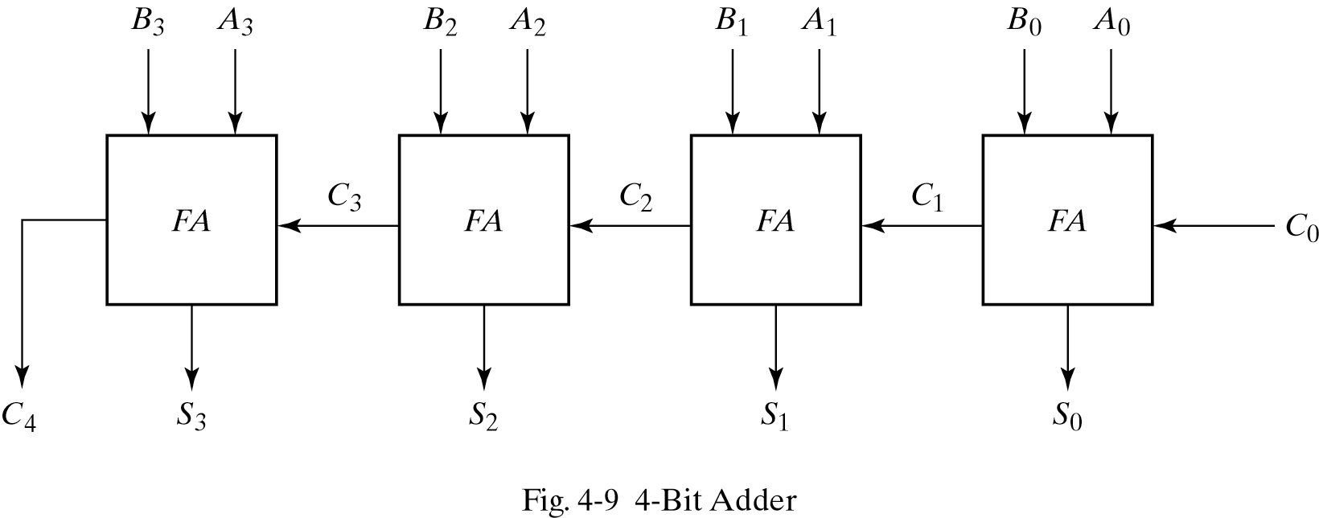
Binary adder
This is also called Ripple Carry Adder ,because of the construction with full adders are connected in cascade.

Slide 16
Carry Propagation
Fig.4-9 causes a unstable factor on carry bit, and produces a longest propagation delay.
The signal from C_{i} to the output carry C_{i+1}, propagates through an AND and OR gates, so, for an n-bit RCA, there are 2n gate levels for the carry to propagate from input to output.

Slide 17
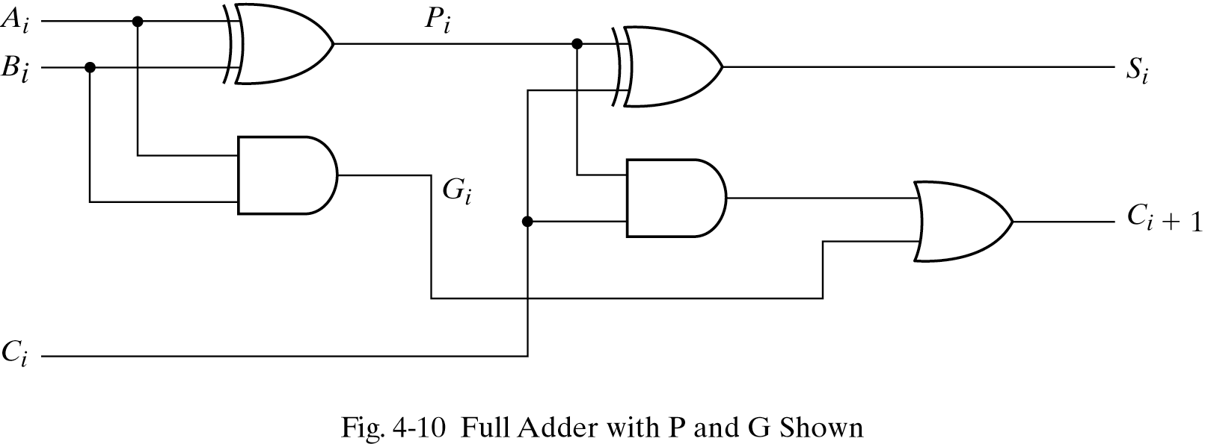
Carry Propagation
Because the propagation delay will affect the output signals on different time, so the signals are given enough time to get the precise and stable outputs.
The most widely used technique employs the principle of carry look-ahead to improve the speed of the algorithm.

Slide 18
Boolean functions
P_{i} = A_{i} ⊕ B_{i} steady state value
G_{i} = A_{i}B_{i} steady state value
Output sum and carry
S_{i} = P_{i} ⊕ C_{i}
C_{i+1} = G_{i} + P_{i}C_{i}
G_{i} : carry generate P_{i} : carry propagate
C₀ = input carry
C₁ = G₀ + P₀C₀
C₂ = G₁ + P₁C₁ = G₁ + P₁G₀ + P₁P₀C₀
C₃ = G₂ + P₂C₂ = G₂ + P₂G₁ + P₂P₁G₀ + P₂P₁P₀C₀
C₃ does not have to wait for C₂ and C₁ to propagate.

Slide 19
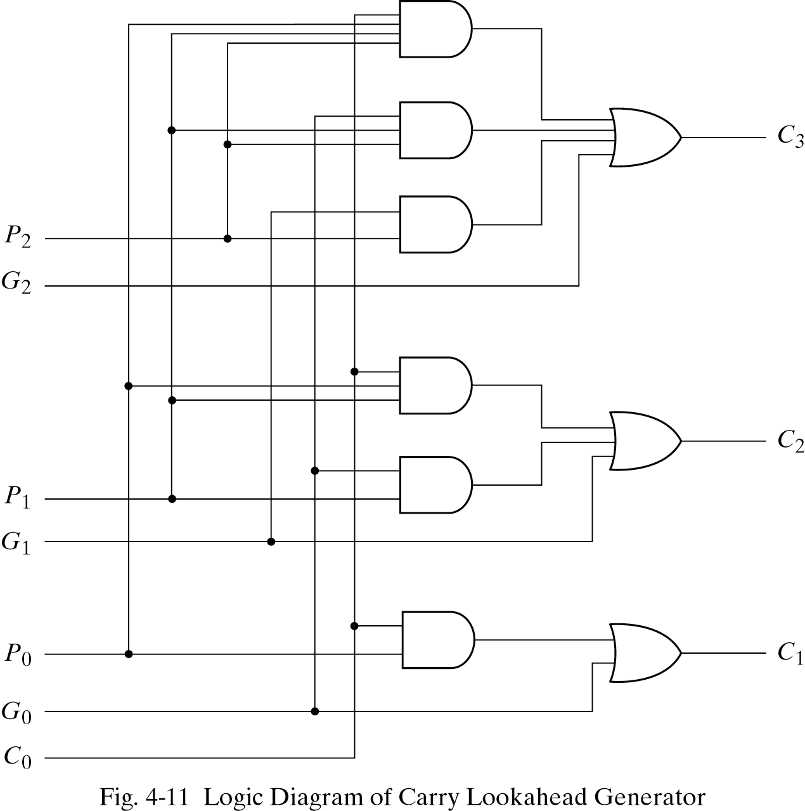
Logic diagram of carry look-ahead generator
C₃ is propagated at the same time as C₂ and C₁.

Slide 20
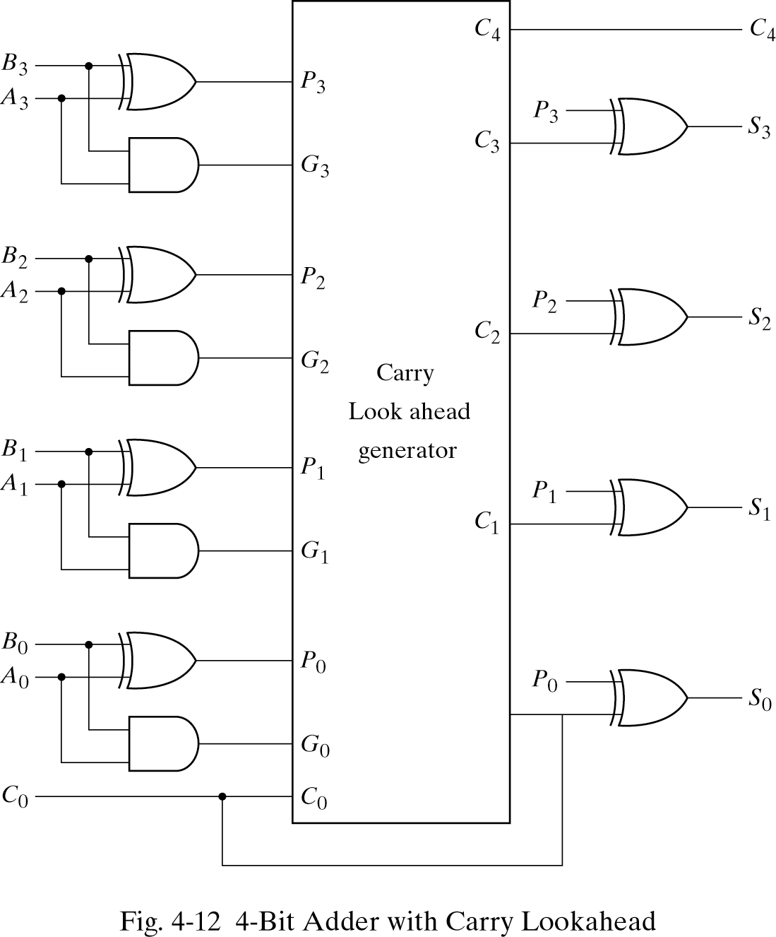
4-bit adder with carry lookahead
Delay time of n-bit CLAA = XOR + (AND + OR) + XOR

Slide 21
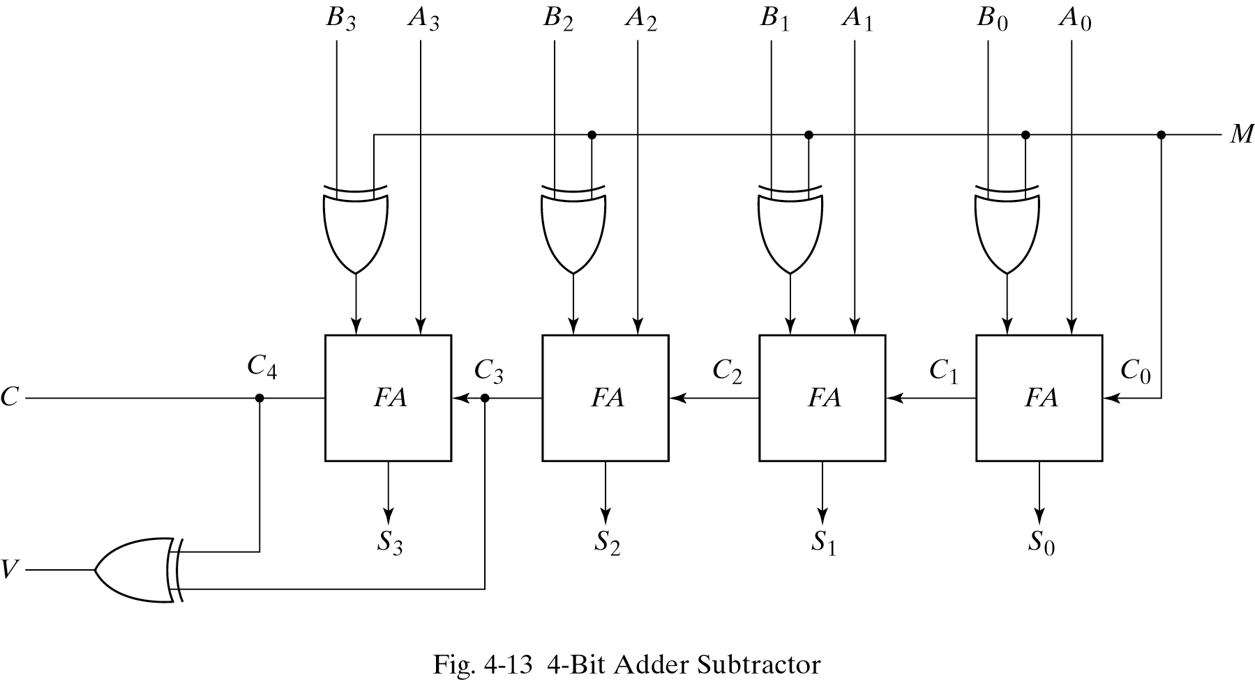
Binary subtractor
M = 1→subtractor ; M = 0→adder

Slide 22
Overflow
It is worth noting Fig.4-13 that binary numbers in the signed-complement system are added and subtracted by the same basic addition and subtraction rules as unsigned numbers.
Overflow is a problem in digital computers because the number of bits that hold the number is finite and a result that contains n+1 bits cannot be accommodated.

Slide 23
Overflow on signed and unsigned
When two unsigned numbers are added, an overflow is detected from the end carry out of the MSB position.
When two signed numbers are added, the sign bit is treated as part of the number and the end carry does not indicate an overflow.
An overflow cann’t occur after an addition if one number is positive and the other is negative.
An overflow may occur if the two numbers added are both positive or both negative.

Slide 24
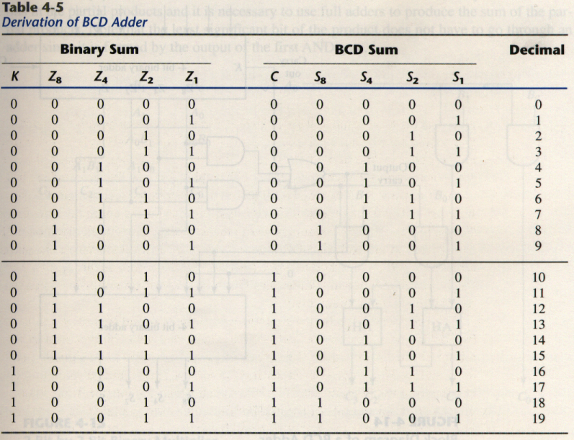
4-5 Decimal adder
BCD adder can’t exceed 9 on each input digit. K is the carry.

Slide 25
Rules of BCD adder
When the binary sum is greater than 1001, we obtain a non-valid BCD representation.
The addition of binary 6(0110) to the binary sum converts it to the correct BCD representation and also produces an output carry as required.
To distinguish them from binary 1000 and 1001, which also have a 1 in position Z₈, we specify further that either Z₄ or Z₂ must have a 1.
C = K + Z₈Z₄ + Z₈Z₂

Slide 26
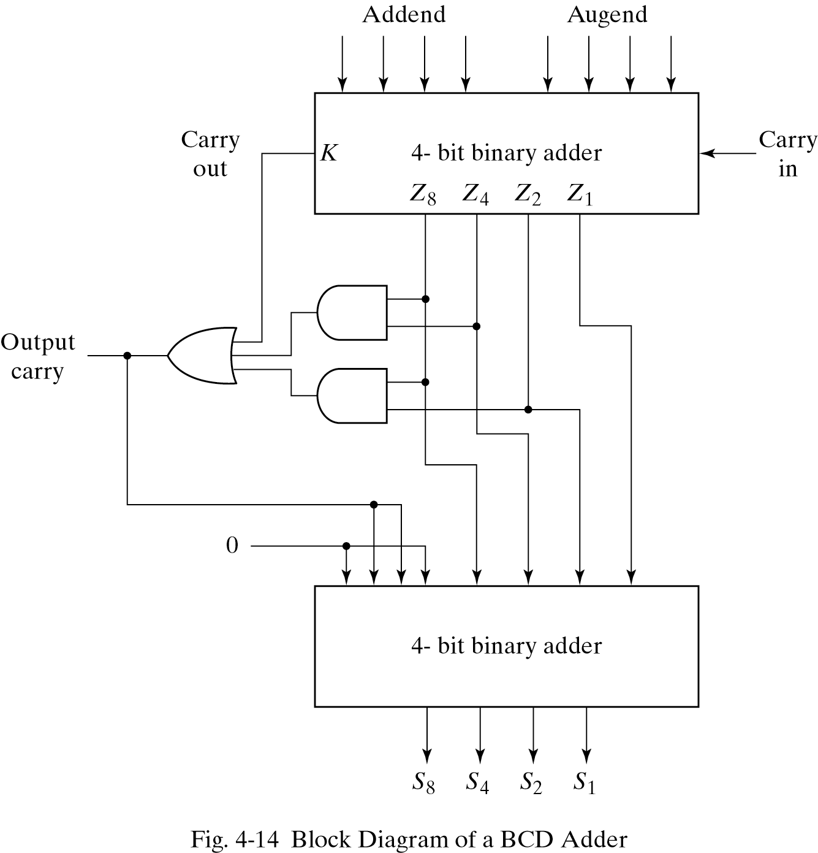
Implementation of BCD adder
A decimal parallel adder that adds n decimal digits needs n BCD adder stages.
The output carry from one stage must be connected to the input carry of the next higher-order stage.
If =1
0110

Slide 27
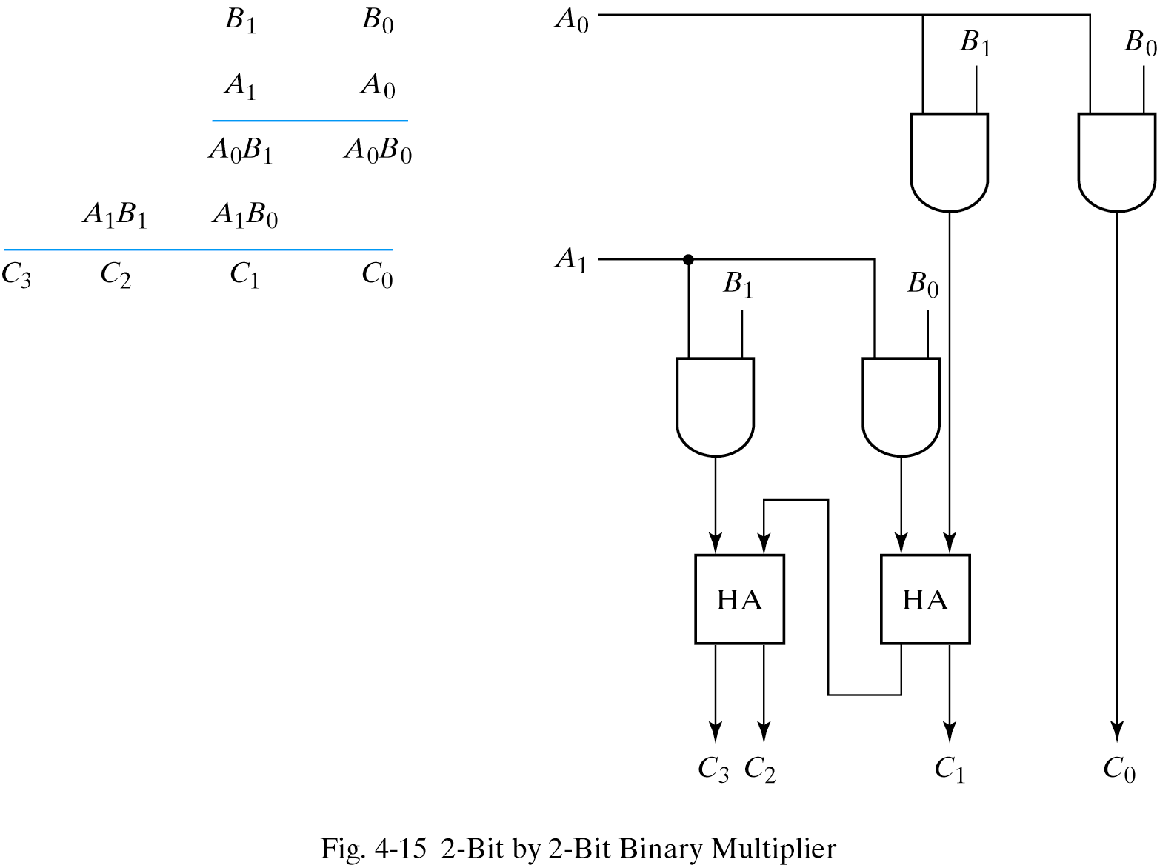
4-6. Binary multiplier
Usually there are more bits in the partial products and it is necessary to use full adders to produce the sum of the partial products.
And

Slide 28
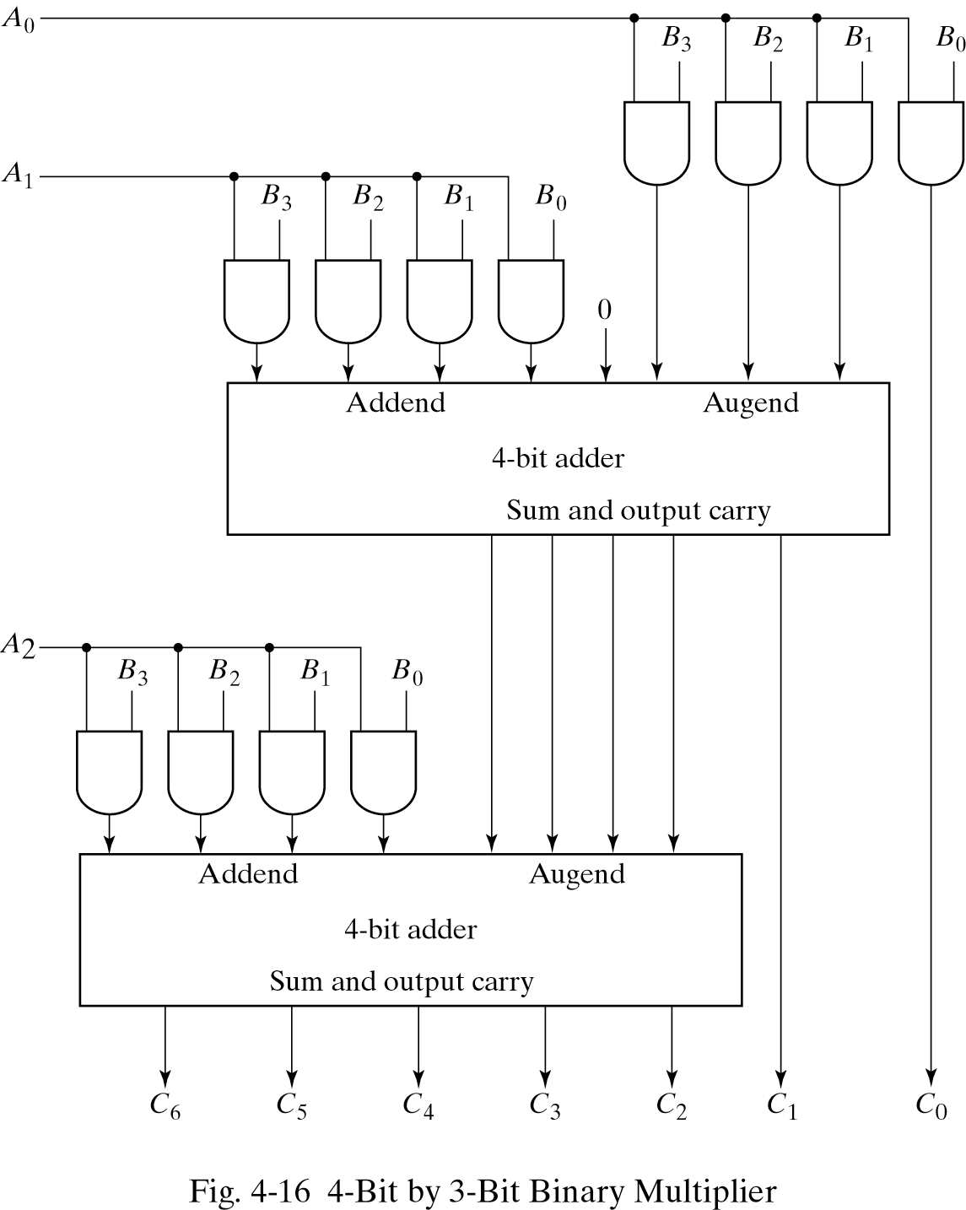
4-bit by 3-bit binary multiplier
For J multiplier bits and K multiplicand bits we need (J X K) AND gates and (J − 1) K-bit adders to produce a product of J+K bits.
K=4 and J=3, we need 12 AND gates and two 4-bit adders.

Slide 29
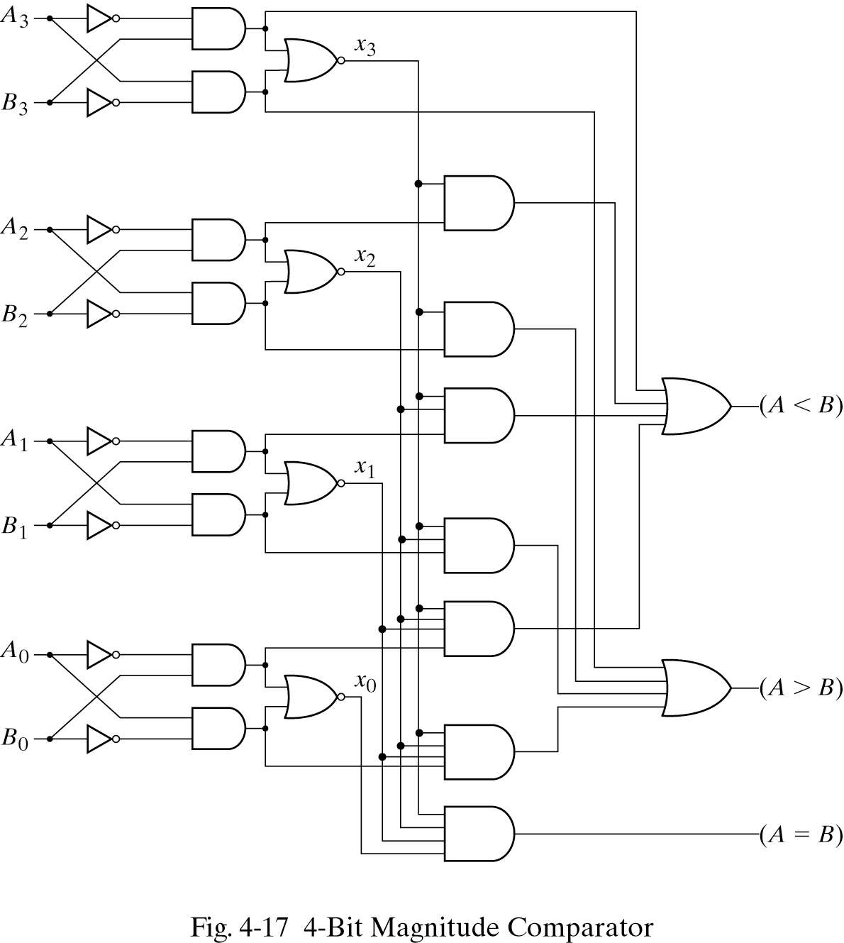
4-7. Magnitude comparator
The equality relation of each pair of bits can be expressed logically with an exclusive-NOR function as:
A = A₃A₂A₁A₀ ; B = B₃B₂B₁B₀
x_{i}=A_{i}B_{i}+A_{i}’B_{i}’ for i = 0, 1, 2, 3
(A = B) = x₃x₂x₁x₀

Slide 30
Magnitude comparator
We inspect the relative magnitudes of pairs of MSB. If equal, we compare the next lower significant pair of digits until a pair of unequal digits is reached.
If the corresponding digit of A is 1 and that of B is 0, we conclude that A>B.
(A>B)=
A₃B’₃+x₃A₂B’₂+x₃x₂A₁B’₁+x₃x₂x₁A₀B’₀
(A<B)=
A’₃B₃+x₃A’₂B₂+x₃x₂A’₁B₁+x₃x₂x₁A’₀B₀

Slide 31
4-8. Decoders
The decoder is called n-to-m-line decoder, where m≤2^{n} .
the decoder is also used in conjunction with other code converters such as a BCD-to-seven_segment decoder.
3-to-8 line decoder: For each possible input combination, there are seven outputs that are equal to 0 and only one that is equal to 1.

Slide 32
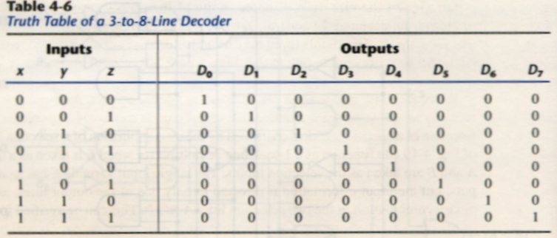
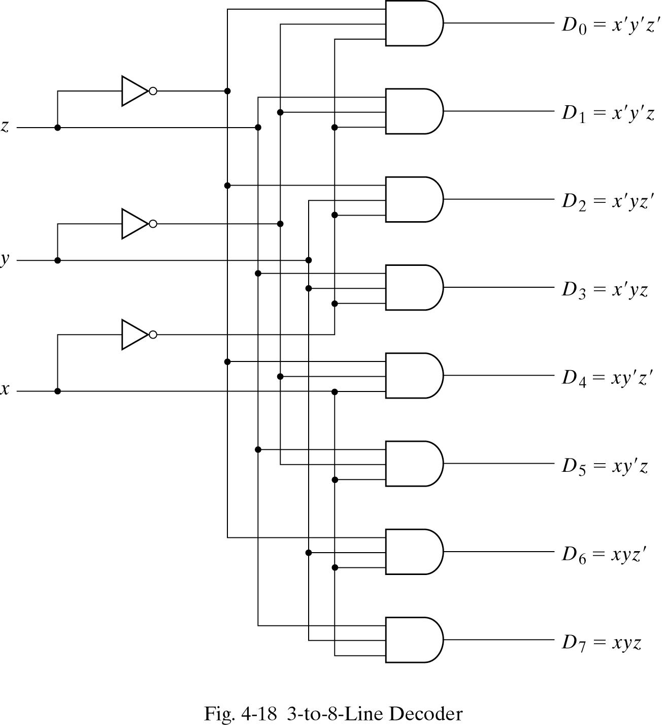
Implementation and truth table

Slide 33
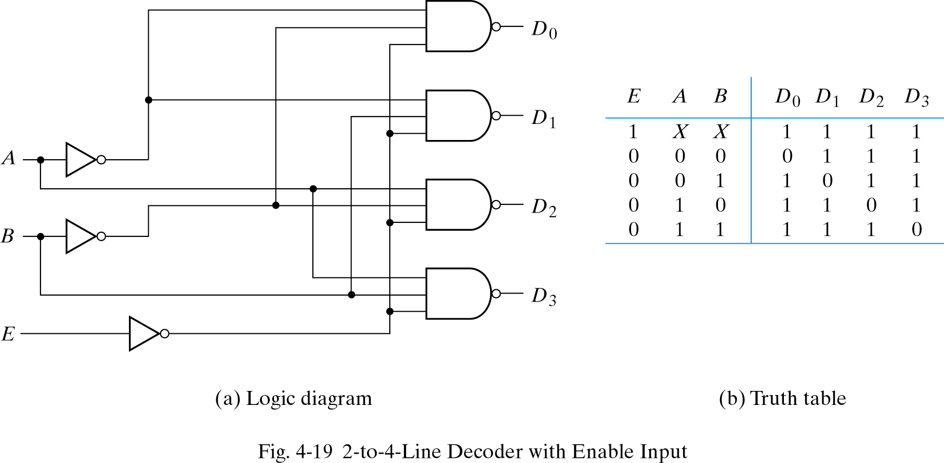
Decoder with enable input
Some decoders are constructed with NAND gates, it becomes more economical to generate the decoder minterms in their complemented form.
As indicated by the truth table , only one output can be equal to 0 at any given time, all other outputs are equal to 1.

Slide 34
Demultiplexer
A decoder with an enable input is referred to as a decoder/demultiplexer.
The truth table of demultiplexer is the same with decoder.
A B
Demultiplexer
D0
D1
D2
D3
E

Slide 35
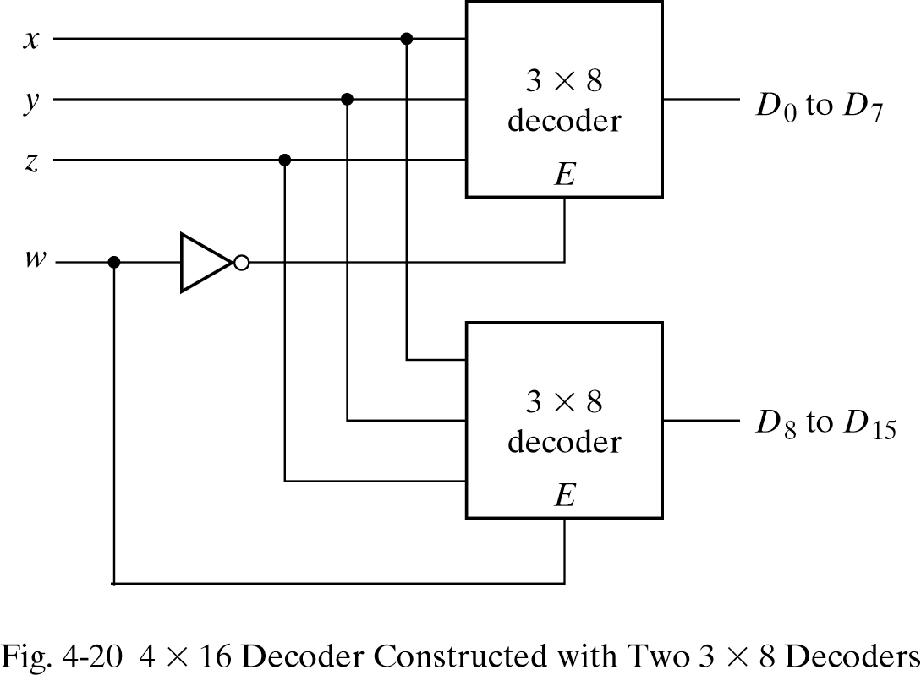
3-to-8 decoder with enable implement the 4-to-16 decoder

Slide 36
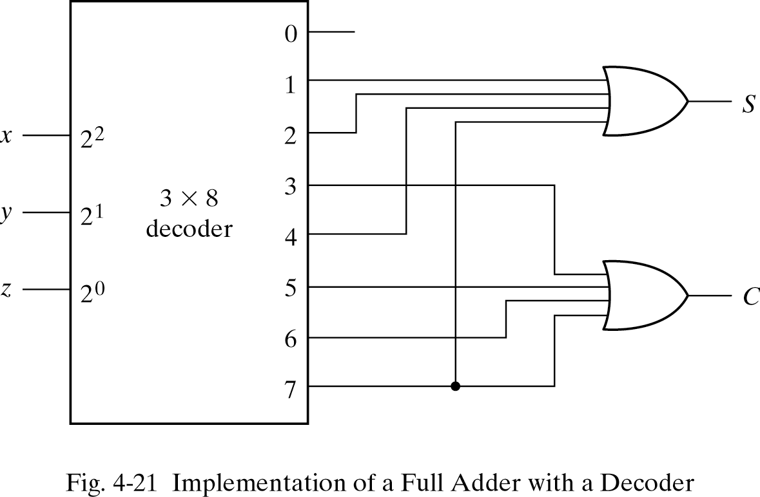
Implementation of a Full Adder with a Decoder
From table 4-4, we obtain the functions for the combinational circuit in sum of minterms:
S(x, y, z) = ∑(1, 2, 4, 7)
C(x, y, z) = ∑(3, 5, 6, 7)

Slide 37
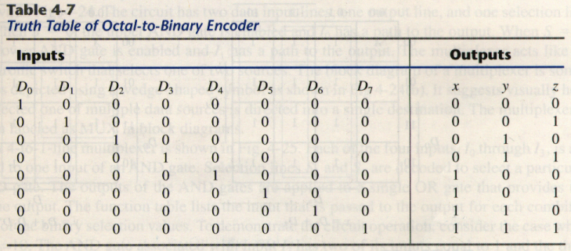
4-9. Encoders
An encoder is the inverse operation of a decoder.
We can derive the Boolean functions by table 4-7
z = D₁ + D₃ + D₅ + D₇
y = D₂ + D₃ + D₆ + D₇
x = D₄ + D₅ + D₆ + D₇

Slide 38
Priority encoder
If two inputs are active simultaneously, the output produces an undefined combination. We can establish an input priority to ensure that only one input is encoded.
Another ambiguity in the octal-to-binary encoder is that an output with all 0’s is generated when all the inputs are 0; the output is the same as when D₀ is equal to 1.
The discrepancy tables on Table 4-7 and Table 4-8 can resolve aforesaid condition by providing one more output to indicate that at least one input is equal to 1.

Slide 39
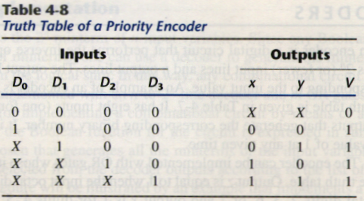
Priority encoder
V=0→no valid inputs
V=1→valid inputs
X’s in output columns represent
don’t-care conditions
X’s in the input columns are
useful for representing a truth
table in condensed form.
Instead of listing all 16
minterms of four variables.

Slide 40
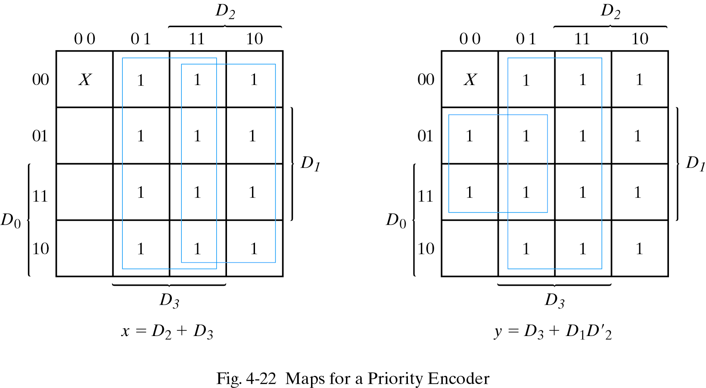
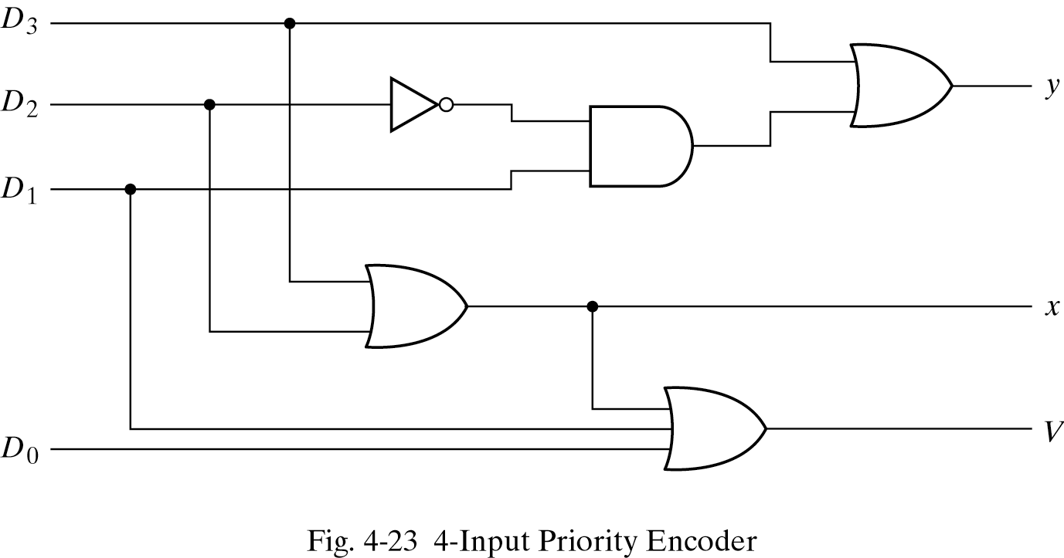
4-input priority encoder
0
Implementation of table 4-8
x = D₂ + D₃
y = D₃ + D₁D’₂
V = D₀ + D₁ + D₂ + D₃
0
0
0

Slide 41
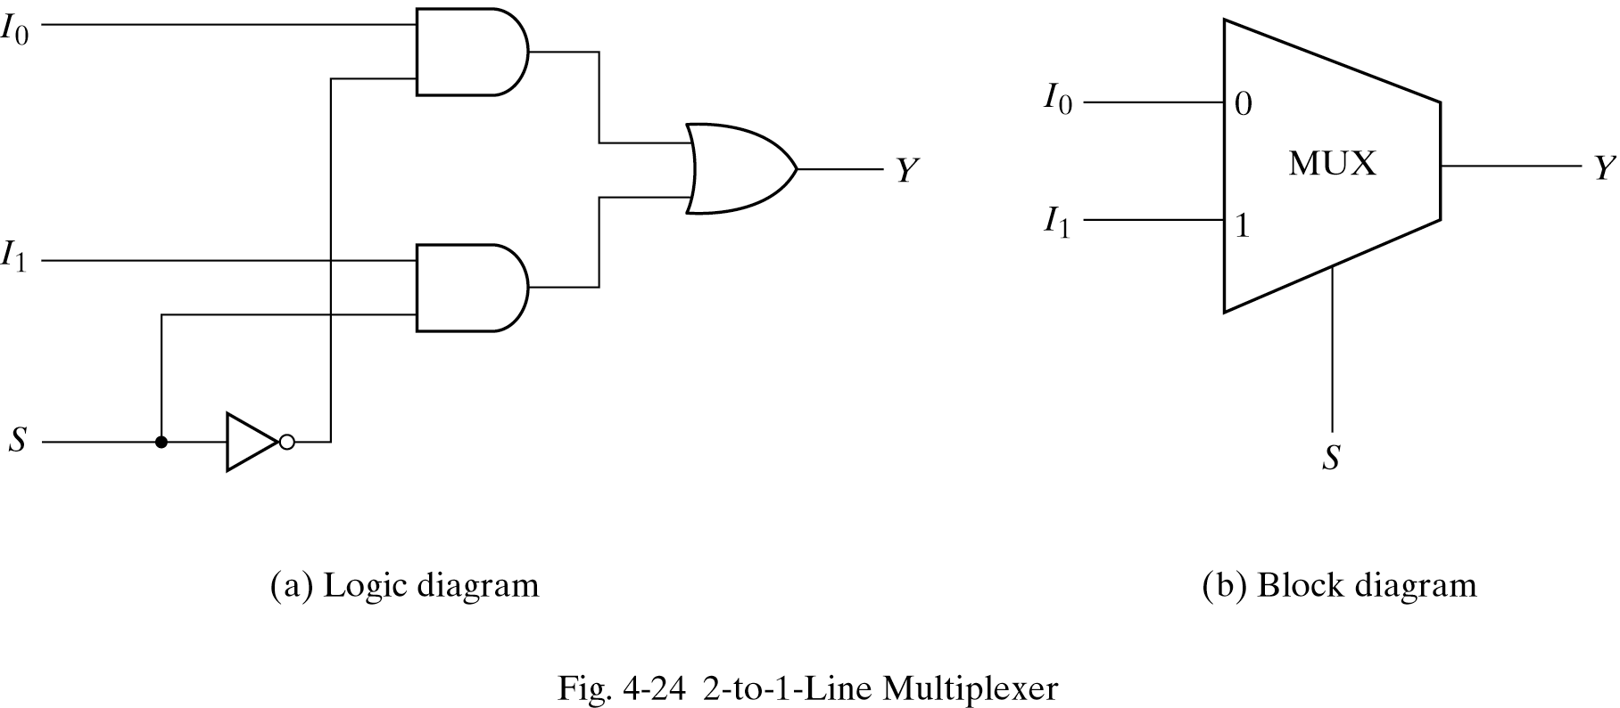
4-10. Multiplexers
S = 0, Y = I₀ Truth Table→ S Y Y = S’I₀ + SI₁
S = 1, Y = I₁ 0 I₀
1 I₁

Slide 42
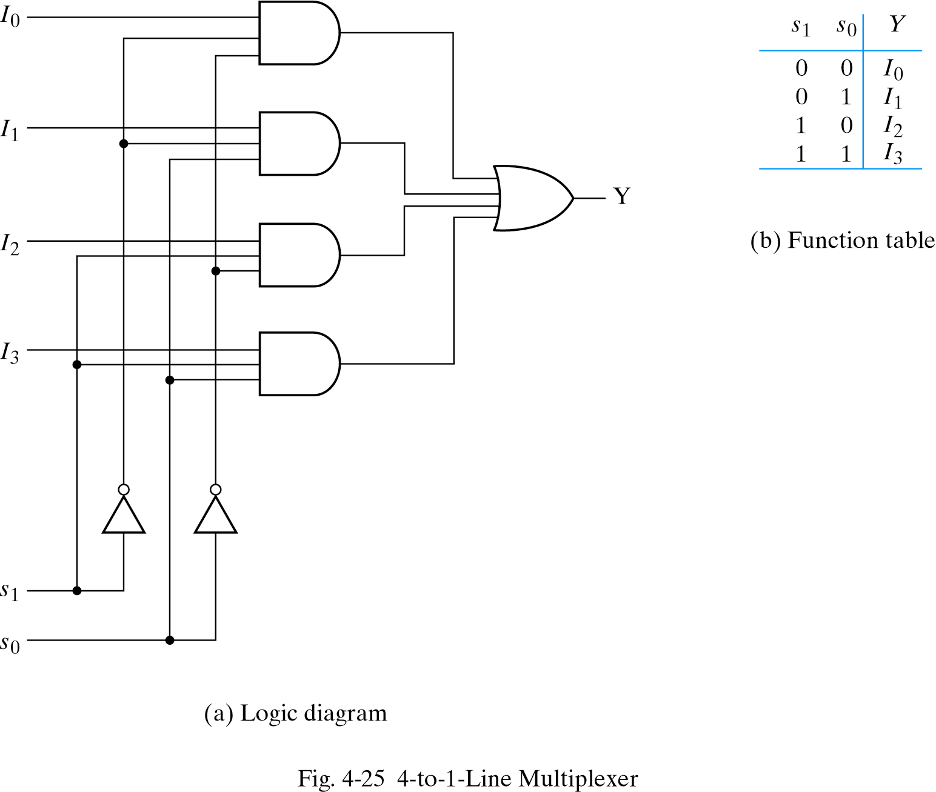
4-to-1 Line Multiplexer

Slide 43
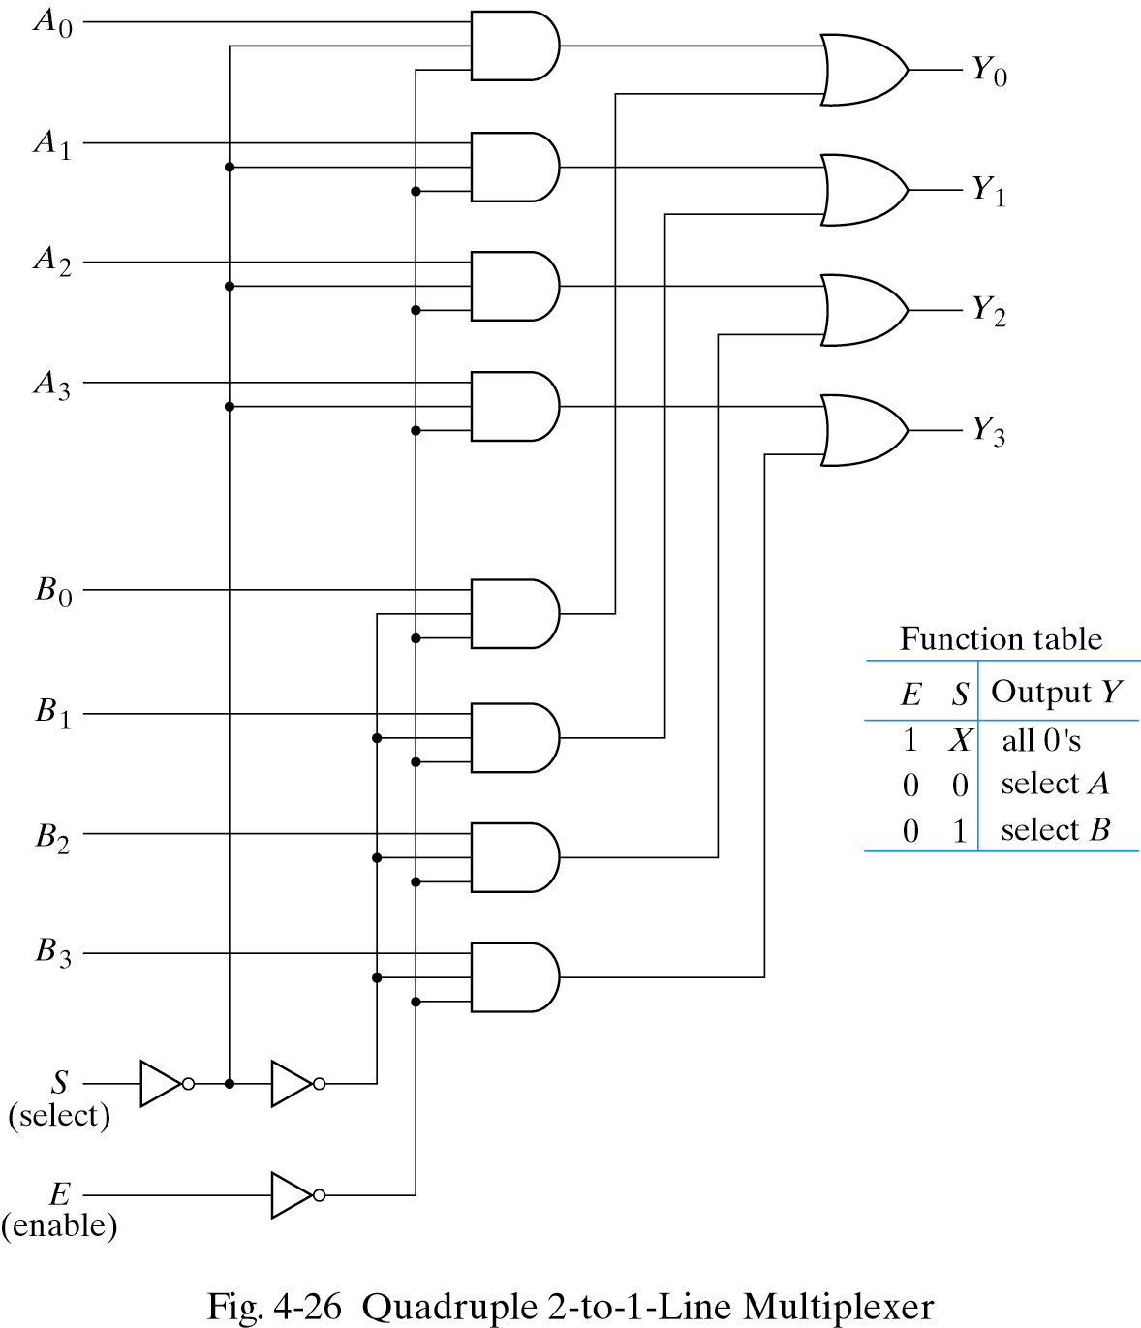
Quadruple 2-to-1 Line Multiplexer
Multiplexer circuits can be combined with common selection inputs to provide multiple-bit selection logic. Compare with Fig4-24.
I₀
Y
I₁

Slide 44
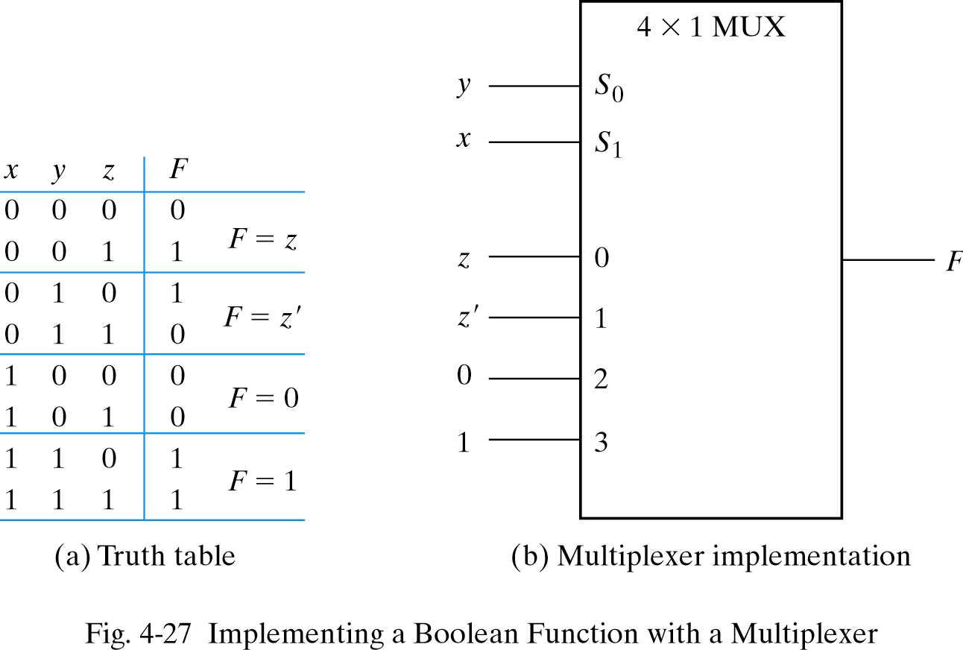
Boolean function implementation
A more efficient method for implementing a Boolean function of n variables with a multiplexer that has n-1 selection inputs.
F(x, y, z) = Σ(1,2,6,7)

Slide 45
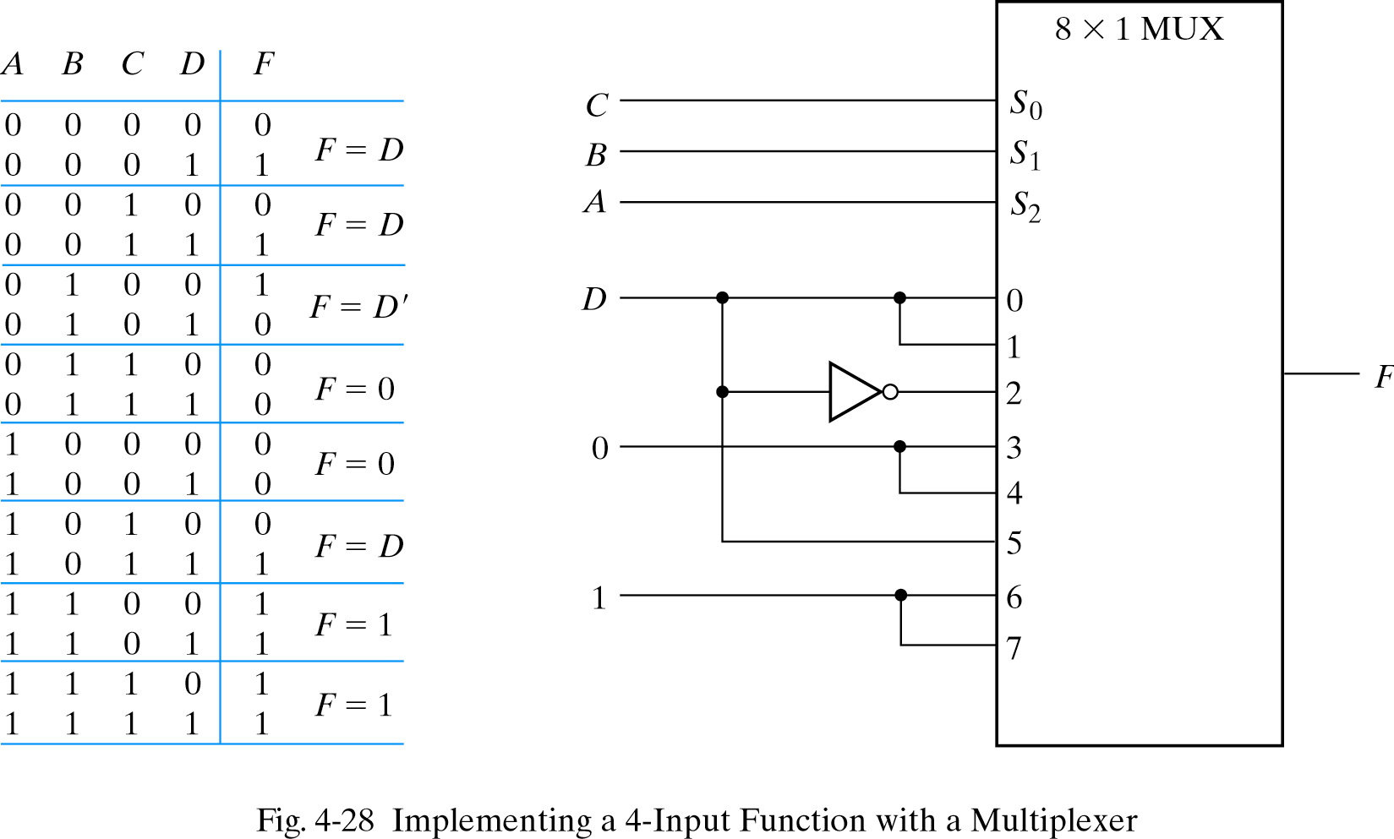
4-input function with a multiplexer
F(A, B, C, D) = Σ(1, 3, 4, 11, 12, 13, 14, 15)

Slide 46
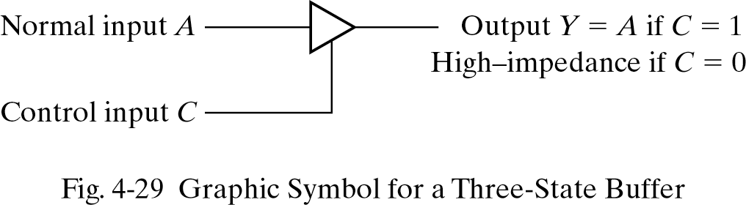
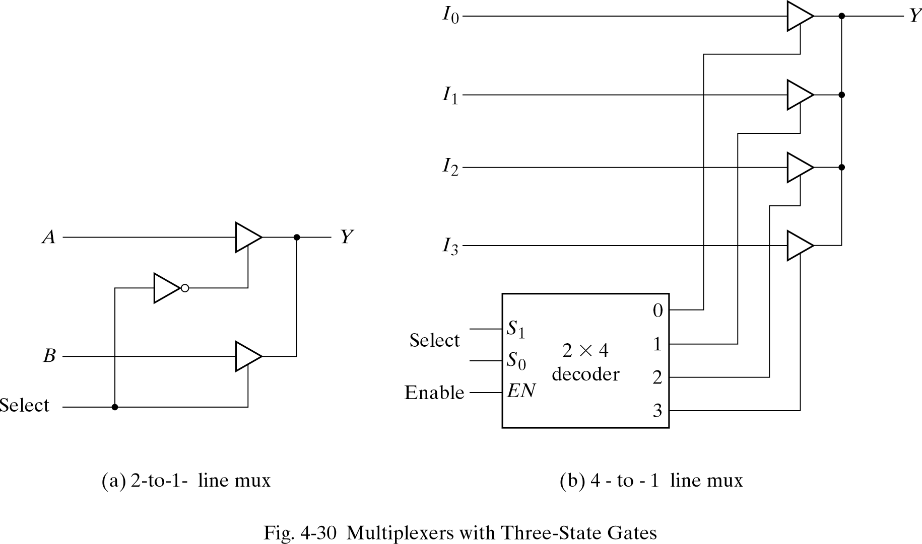
Three-State Gates
A multiplexer can be constructed with three-state gates.

